Slide 1
Data management project presentation

Slide 2
Project idea
The aim of the project is to aggregate data from various sources, including information on air pollution, cancer-related deaths, and the socio-economic status of different countries.
All data is organized by year and by the country to which it pertains.
The goal of the resulting analysis is to correlate cancer data with the population’s current living conditions.

Slide 3
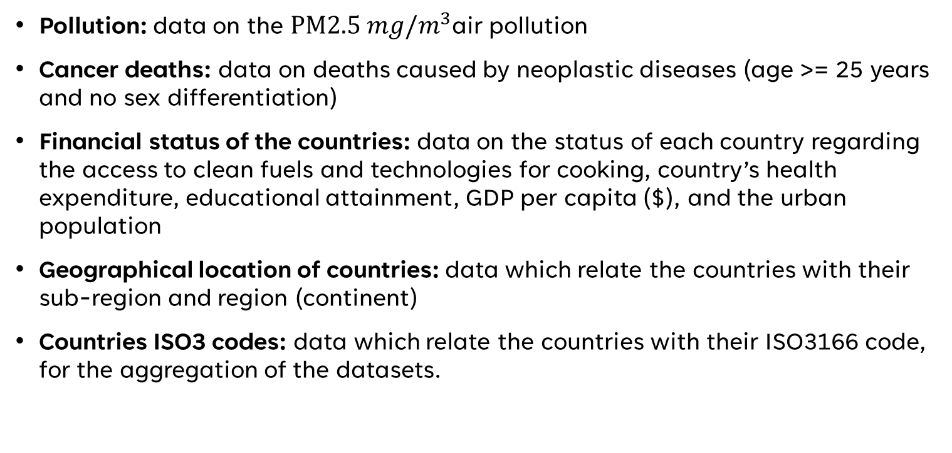
Data sources
Pollution: data on the $PM2.5 mg/m^{3}$air pollution
Cancer deaths: data on deaths caused by neoplastic diseases (age >= 25 years and no sex differentiation)
Financial status of the countries: data on the status of each country regarding the access to clean fuels and technologies for cooking, country’s health expenditure, educational attainment, GDP per capita ($), and the urban population
Geographical location of countries: data which relate the countries with their sub-region and region (continent)
Countries ISO3 codes: data which relate the countries with their ISO3166 code, for the aggregation of the datasets.

Slide 4
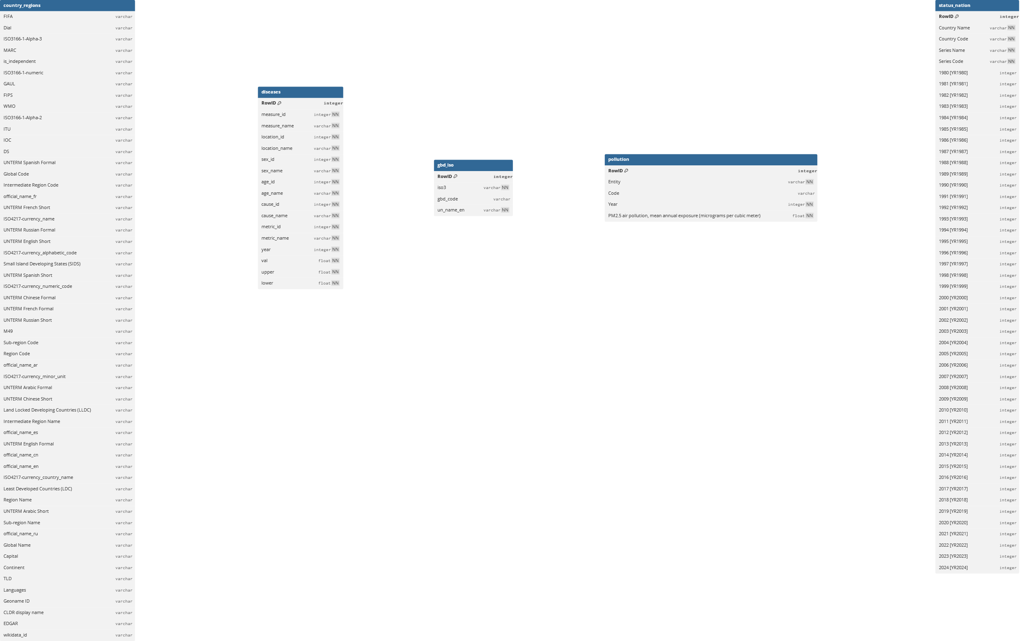
Relational schemas datasources

Slide 5
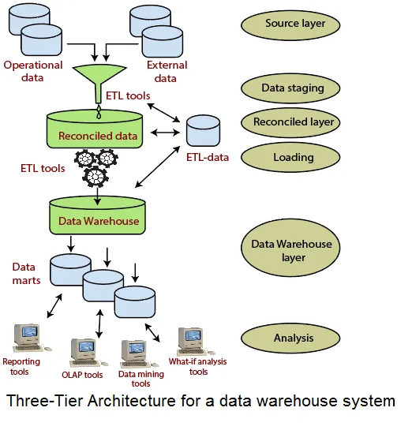
DATA WAREhouse architecture

Slide 6
Conceptual schema reconciled data layer
id
Pollution
PM2_5_value_mg_m3
(1,N)
(1,N)
In_p
Location_p
Region Name
year_key
Sub-region Name
year
Country Name
Year
Location
location_key
iso3
Continent
In_d
Location_d
In_s
Location_s
(1,N)
(1,N)
(1,N)
(1,N)
cause name
current_health_expenditure_GDP
Disease
Status-Nation
GDP_per_capita_USD
measure_name
urban_population
metric_name
id
age_name
lower
val
educational_attaintment_completed_secondary
id
sex_name
upper
access_to_clean_fuels_and_technologies_for_cooking

Slide 7
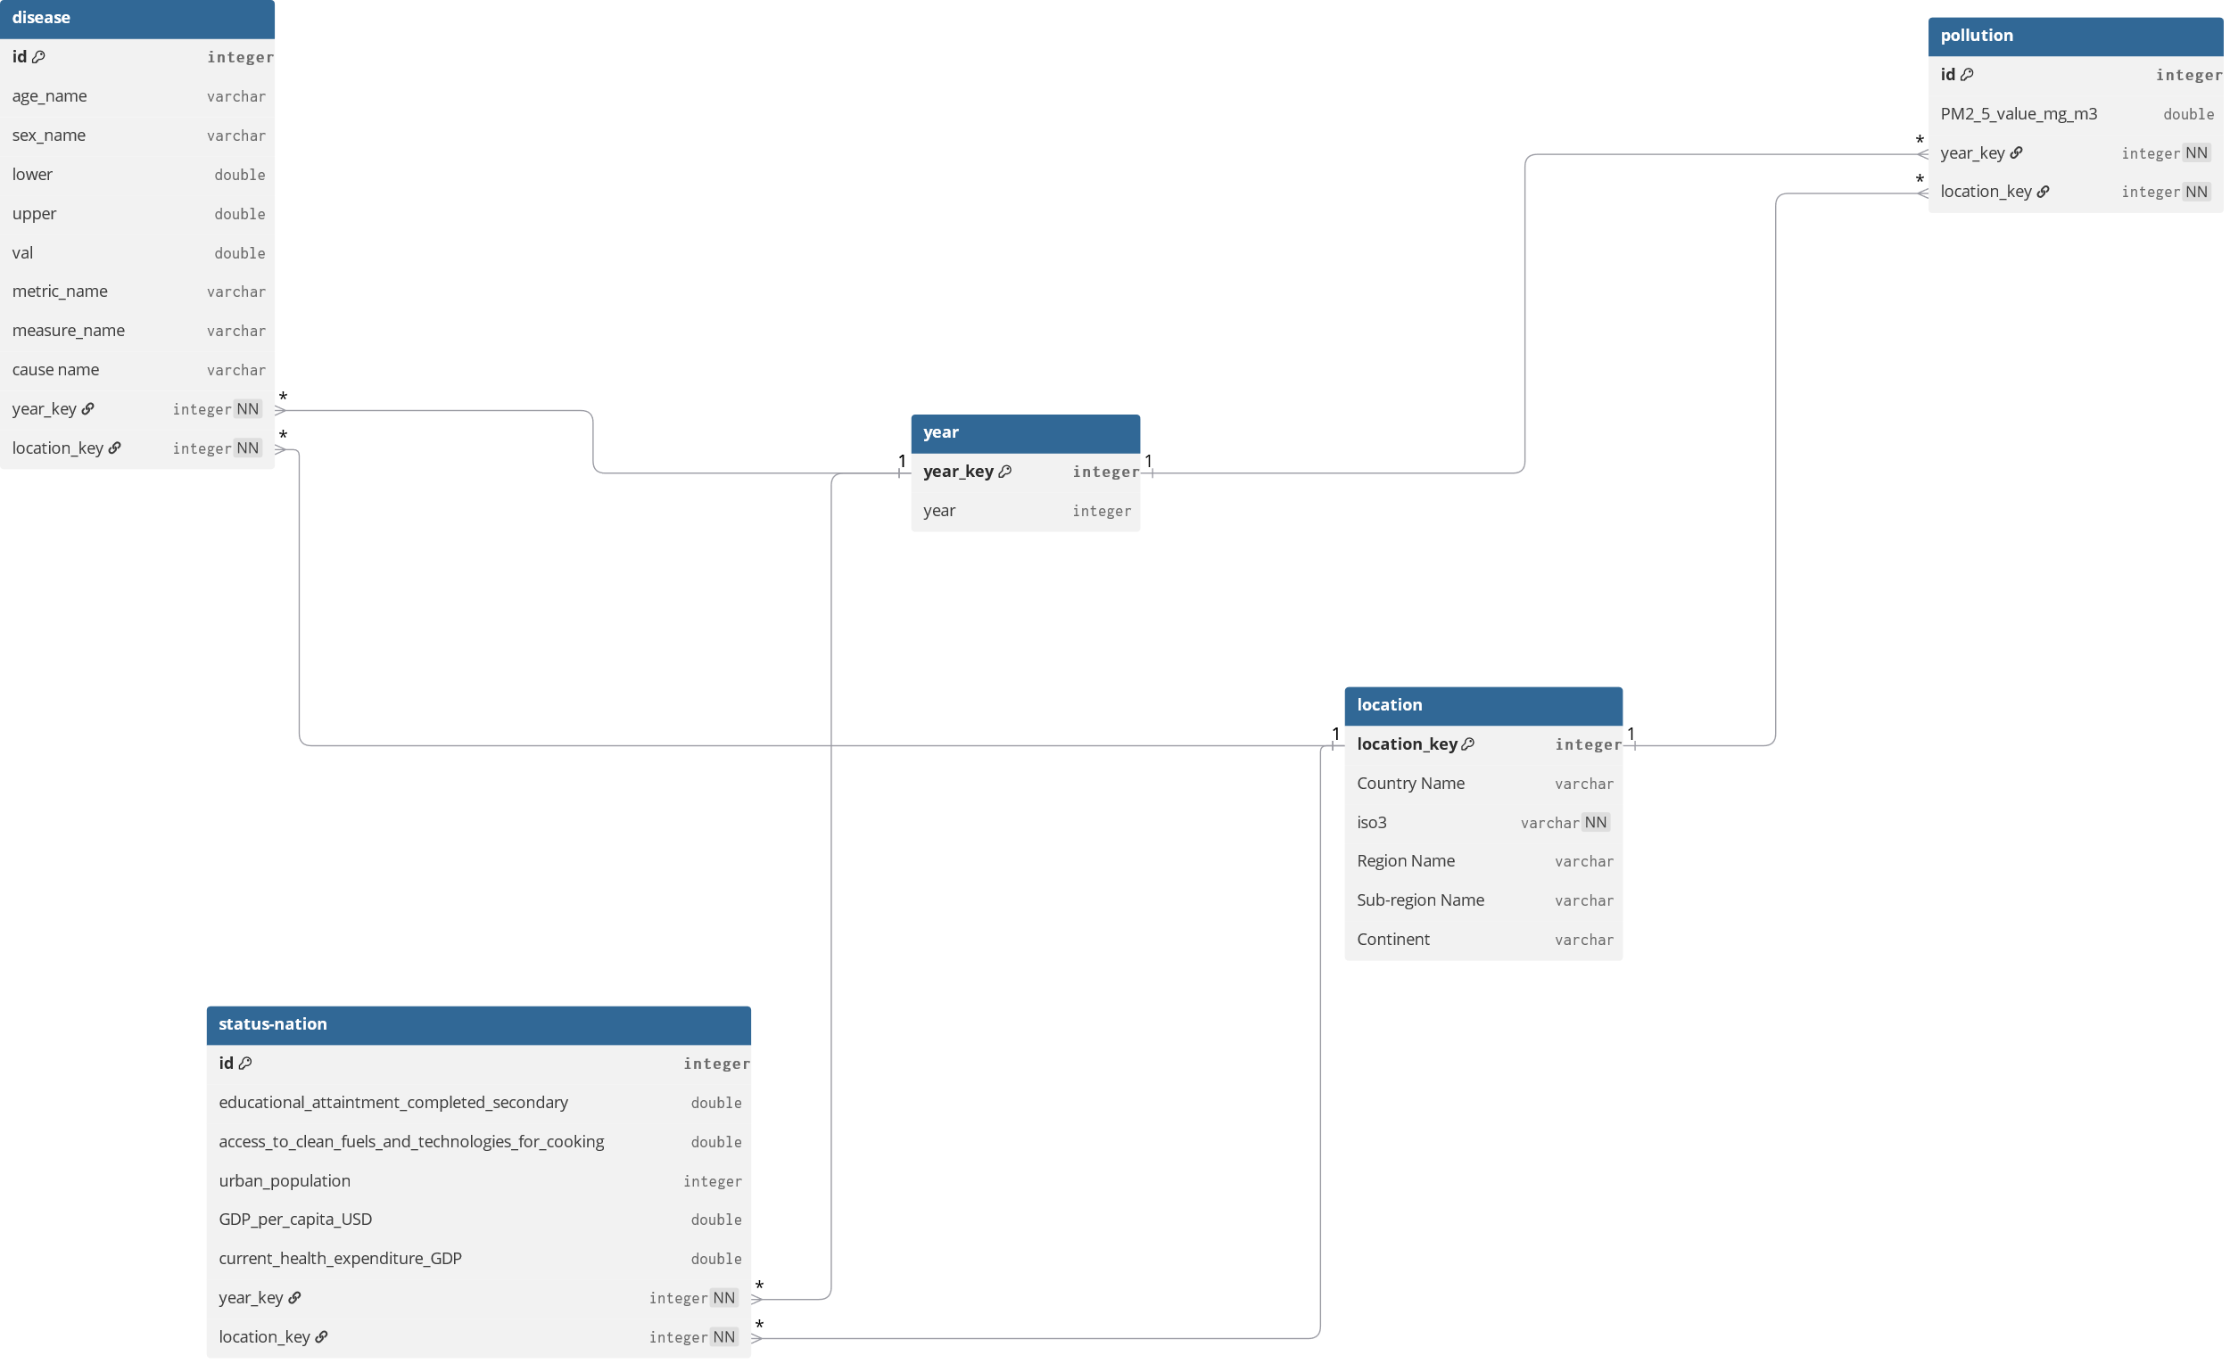
Relational schema reconciled data layer

Slide 8
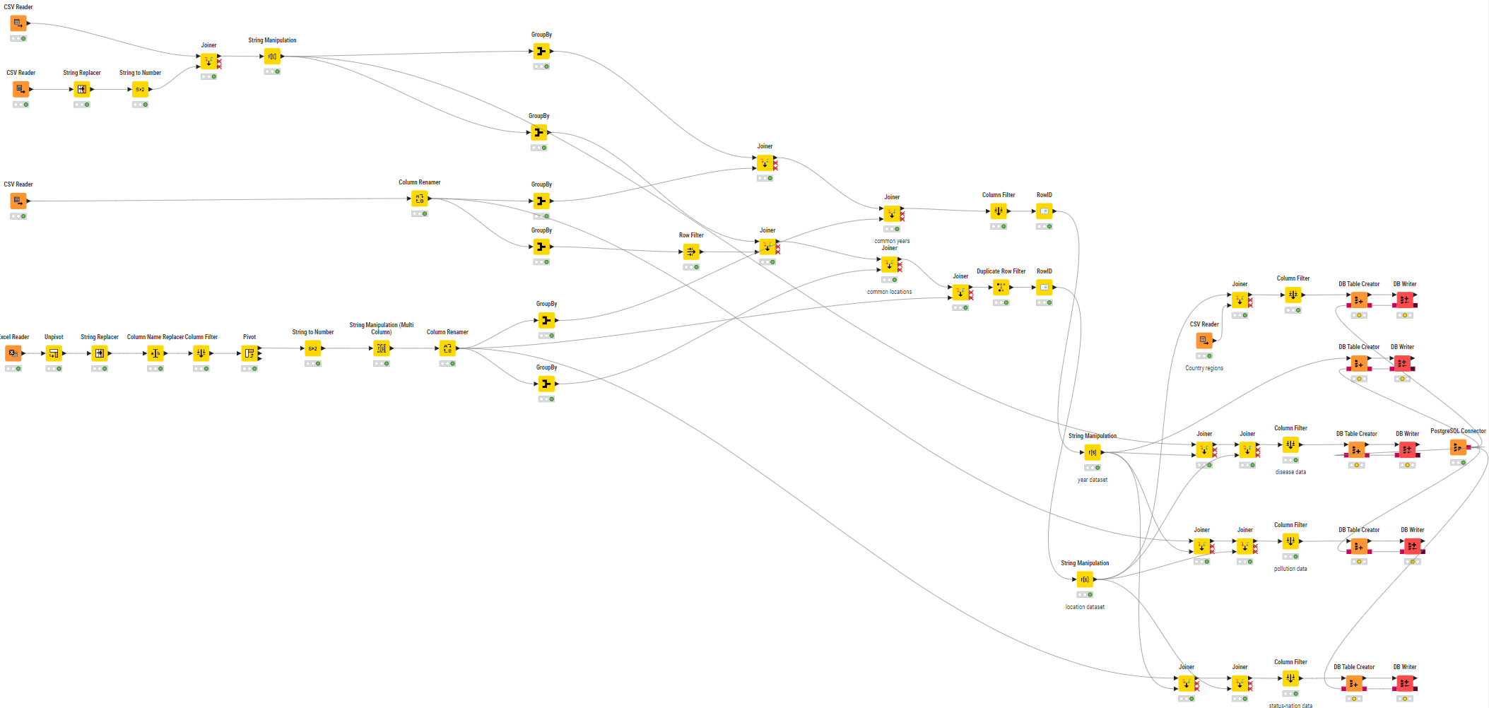
knime
Disease data
Common years
Year table
Common countries
Location table
Iso3 data
Countries data
DB connection
Pollution data
Status nation data
Disease table
Pollution table
Status nation table

Slide 9
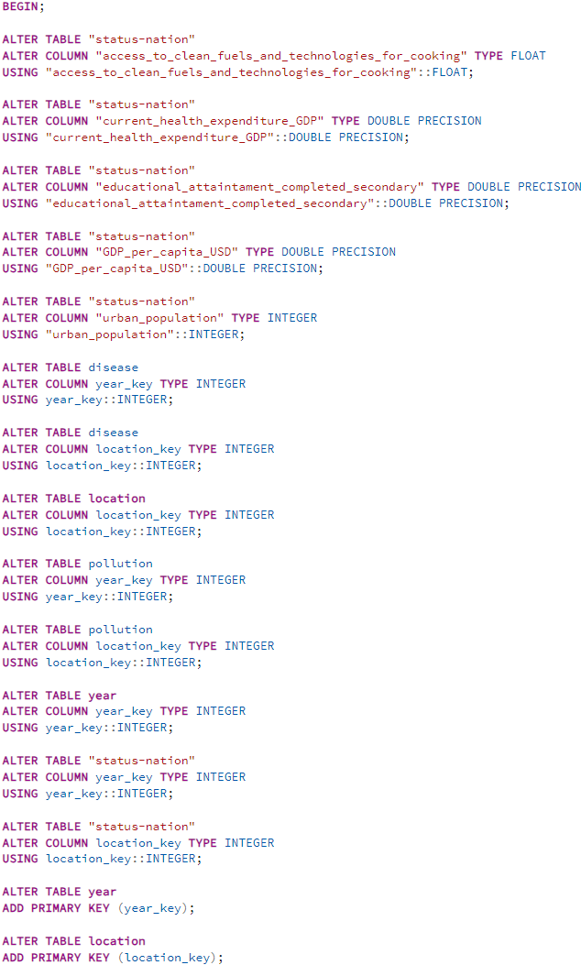
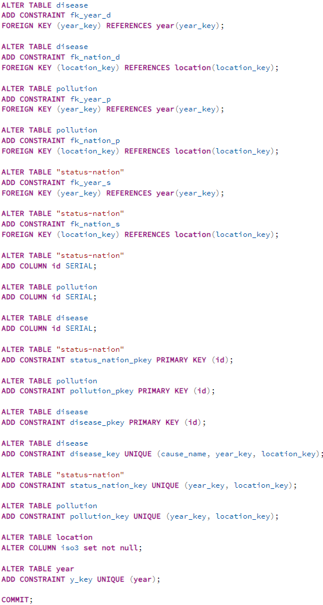

Slide 10
DFM requirements
For each disease I want to know the statistics about the deaths and the name of the cause
For each disease I want to know the location, year, the current air pollution value and the status of the country (only health expenditure, GDP per capita and access to clean fuels and technologies for cooking)
The following are some typical questions for building the data marts used to start OLAP sessions on the data warehouse by business analysts:
Calculate the average number of deaths in a certain country over each decade
Calculate the average number of deaths in a certain year over each continent and over each sub-region

Slide 11
DFM schema
Disease
access to clean fuels and technologies for cooking
decade
year
val
upper
GDP per capita USD
lower
status nation
cause_name
current health expenditure GDP
location
sub region
PM2.5 value mg/m3
region
year, location and cause_name form an identifier for Disease

Slide 12
star schema
Location
Year
key_year
key_location
year
location
decade
sub_region
region
Integrity constraints 1:
1) year is a key for Year
2) location is a key for Location
Integrity constraints 2:
1) decade is derived from year in Year
Disease
key_year
key_location
key_status_nation
key_pm2_5
cause_name
val
upper
lower
Status Nation
Pollution
key_status_nation
key_pm2_5
access_to_clean_fuels_and_technologies_for_cooking *
pm2_5_value_mg_m3
GDP_per_capita_USD *
current_health_expenditure_GDP *

Slide 13
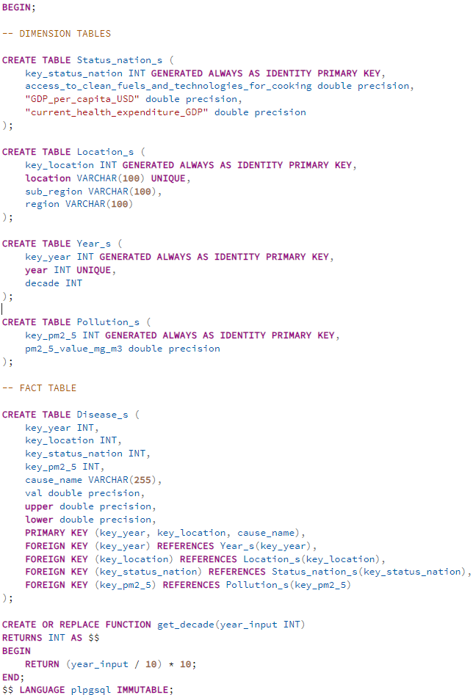
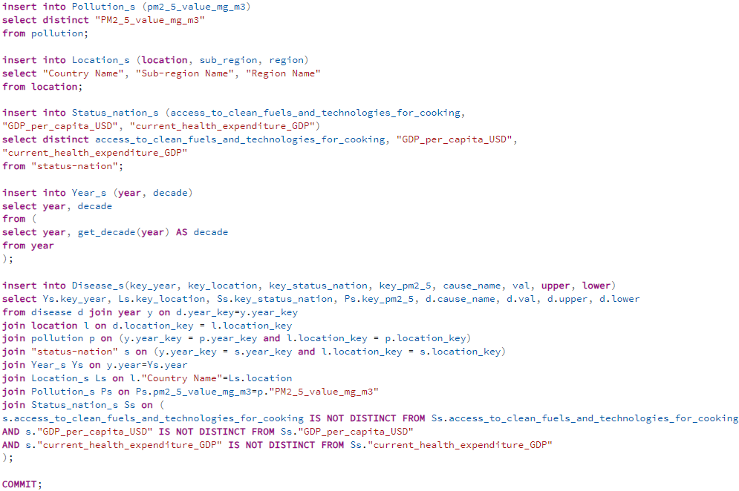
Star schema population

Slide 14
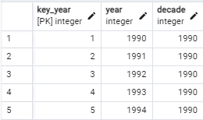
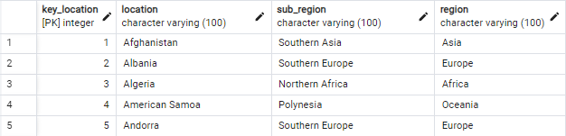
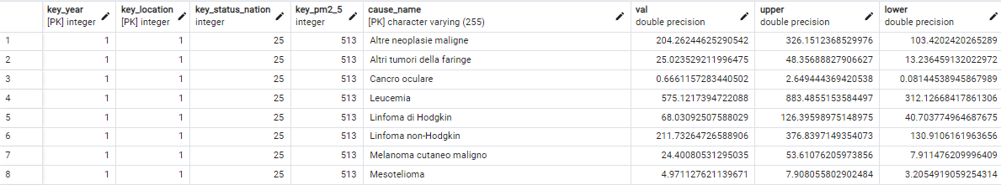
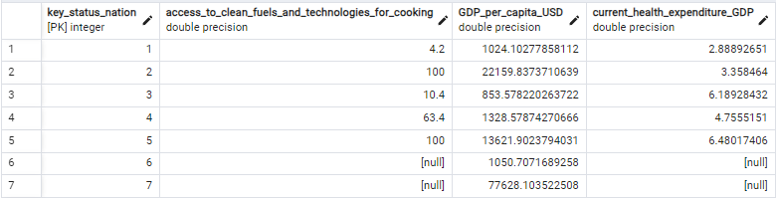
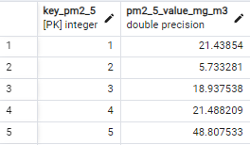
A snippet of the data Warehouse

Slide 15

thanks
Francesco Saverio Sconocchia Pisoni
1889241

